Slide 1
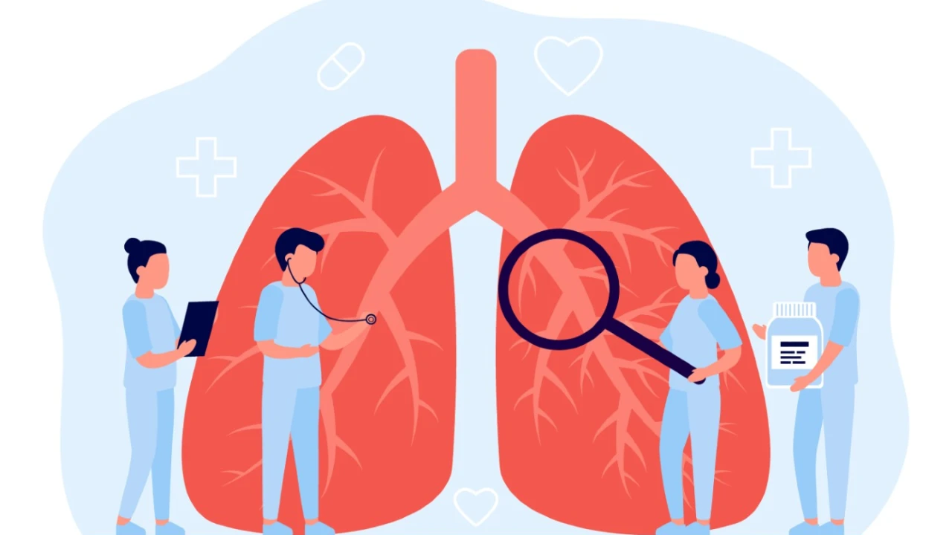
Lung Cancer Risks
Mohamed Mohamed
U3262459
Mohamed Mohamed
U3262459

Slide 2
Table of Contents
-> Description
-> Questions
-> EDA
-> PDA
-> Development

Slide 3
Description
Lung cancer is the leading cause of cancer death and the fifth most common cancer diagnosis in Australia(Cancer Council)
The average age of diagnosis being 71 (Cancer Council)
With the survival rate of cancer being very low with “around 40 out of every 100 people (around 40%) survive their cancer for 1 year or more around 15 out of every 100 people (around 15%) will survive their cancer for 5 years or more 10 out of every 100 people (10%) will survive their cancer for 10 years or more” according to cancer research UK (cancer research UK)

Slide 4

Questions
What is the most contributing factor to Lung Cancer?
What is the distribution between high, medium and low risk?
What is the most common age?
What is the least contributing symptom for lung cancer?
What is the correlation between smoking and lung cancer?

Slide 5
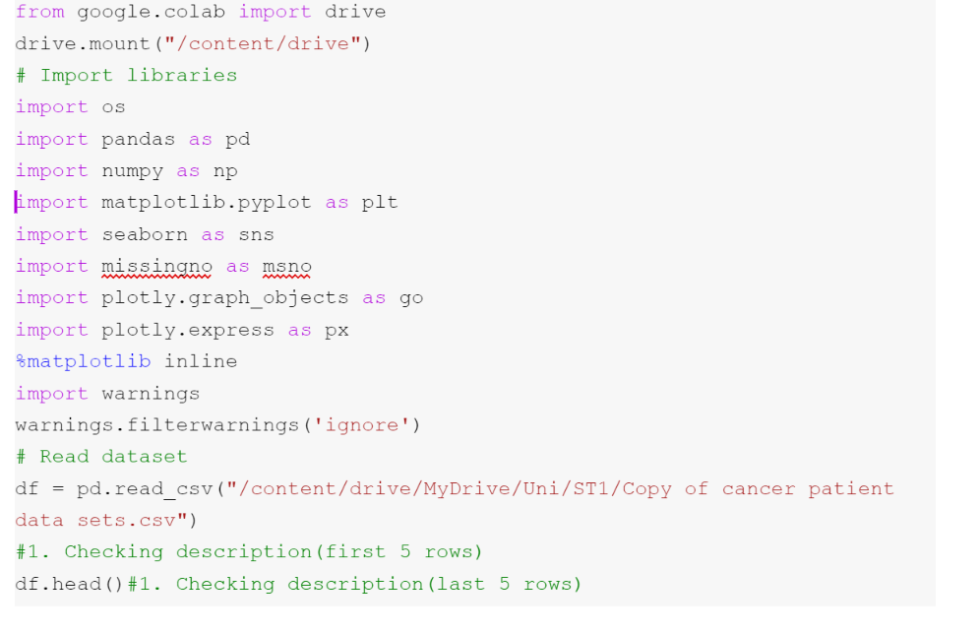
EDA
Libraries used
Reading the data set
Check the description for first 5 and last 5 rows
Figuring out graphs needed

Slide 6
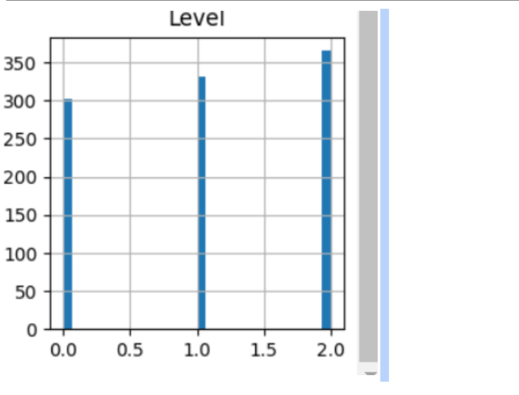
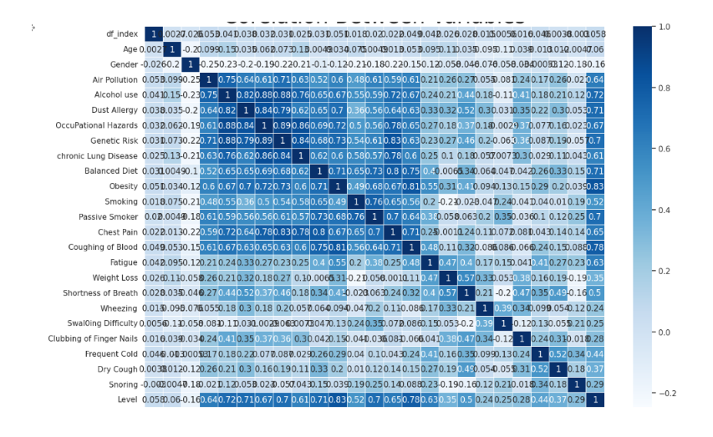
EDA cont.

Slide 7
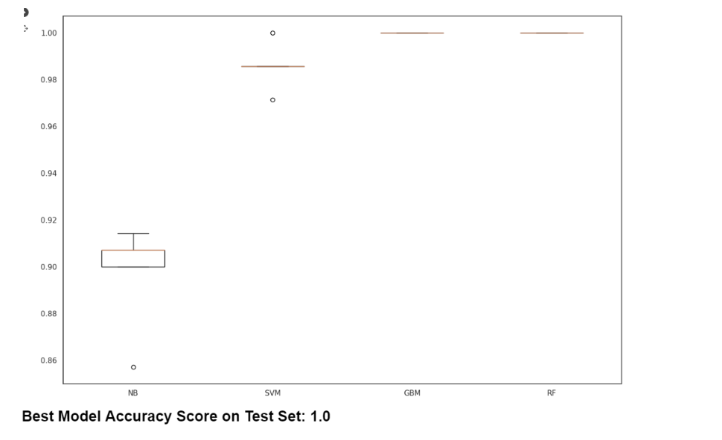
PDA
Performance on Training set
NB: 0.897143 (0.020504)
SVM: 0.985714 (0.009035)
GBM: 1.000000 (0.000000)
RF: 1.000000 (0.000000)
Steps implemented were:
Pre processing
Model testing
Comparing different classification algorithms
Evaluating each model
Compare performance
Confusion matrix

Slide 8
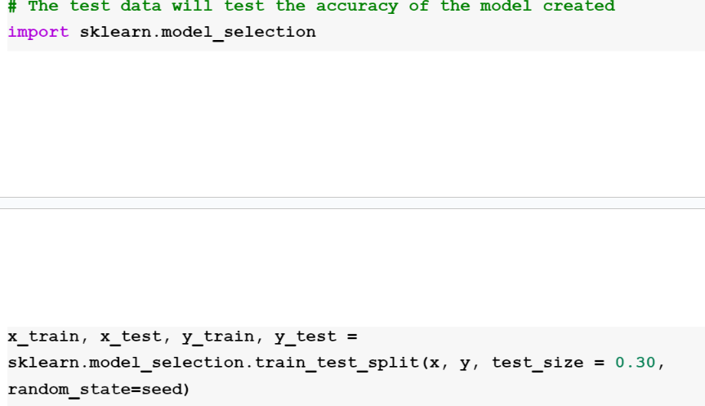
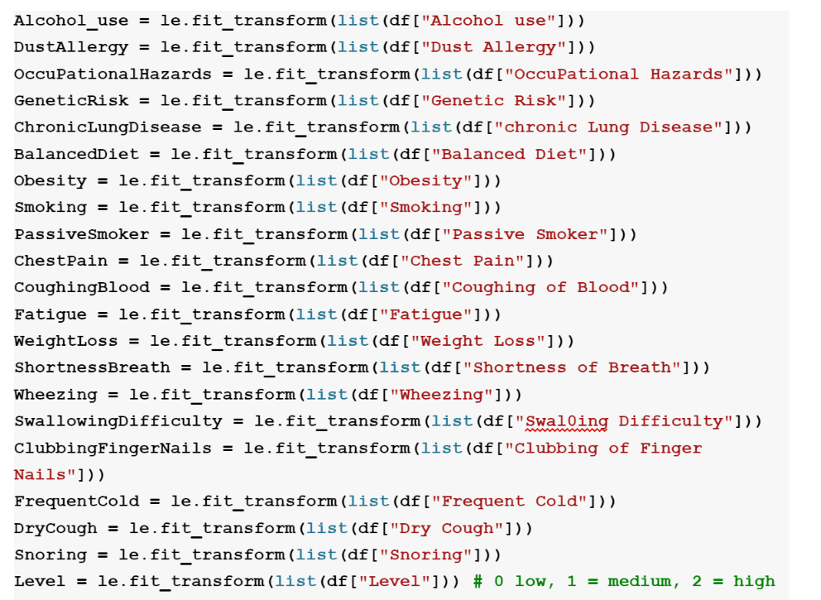
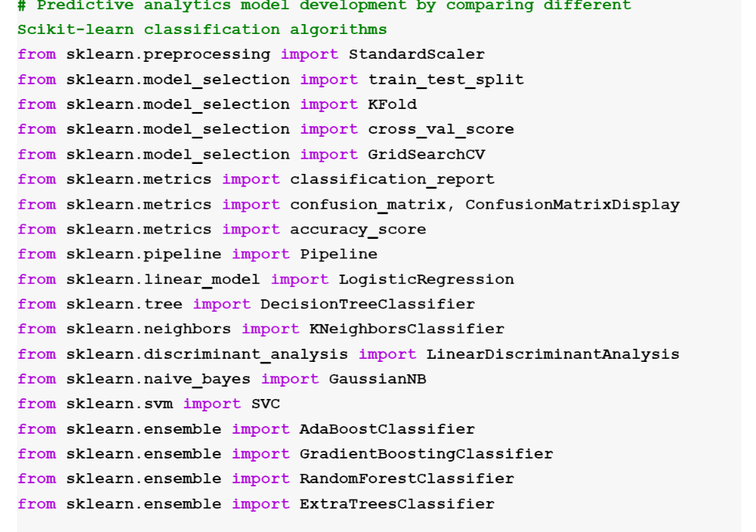
PDA con.

Slide 9
Development
-> Tkinter to implement a GUI
-> Tkinter was also used to Deploy the GUI

Slide 10
Bibliography
Cancer council, 2023, ‘Lung cancer’, https://www.cancer.org.au/cancer-information/types-of-cancer/lung-cancer
Cancer Research UK, 2022, ‘Survival for lung cancer’, https://www.cancerresearchuk.org/about-cancer/lung-cancer/survival#:~:text=Survival%20for%20all%20stages%20of%20lung%20cancer&text=around%2040%20out%20of%20every,for%2010%20years%20or%20more
The Devastator, 2022, ‘Lung Cancer Prediction’, Kaggle, ‘https://www.kaggle.com/datasets/thedevastator/cancer-patients-and-air-pollution-a-new-link

